Slide 1




SetScene
GROUP 4 PRESENTED BY
BSMALLA MOHAMED
ATRAB ALI
NON ALKHIDIR
AISHA ADAAIKI
AHYA AL WATTAR
SHAHAD MUSA
202204404
202207802
202206484
202206798
202204901
202106046
IMMERSRE. EXPLORE. CREATE.

Slide 2


INTRODUCTION
SetScene is an immersive VR platform that transforms reading into a fully interactive experience. Instead of only imagining a story’s world, users can step directly into it, exploring virtual libraries, walking through scenes, and engaging with environments inspired by their favorite books. From fantasy and sci-fi to classics and modern novels, SetScene brings stories to life and redefines how people experience literature.

Slide 3

WHAT MOTIVATED US?
Traditional reading is a static and solitary activity that can struggle to capture the attention of modern audiences. Many readers want deeper immersion, richer visualization, and a stronger emotional connection to the stories they love.

Slide 4

PROJECT OBJECTIVES
Build immersive VR environments inspired by a wide range of books and genres.
Enhance reader engagement and enjoyment through interactive, story-driven spaces.
Support all types of readers; casual, passionate, genre-specific, or exploratory.

Slide 5
PROJECT OBJECTIVES
cont.
Offer social features like shared libraries, co-exploration, and virtual book clubs.
Grow the platform through curated content, partnerships, and community adoption.

Slide 6

PROJECT DESCRIPTION
SetScene is a VR application that lets users explore literature inside fully crafted 3D worlds. Each book features themed environments; virtual libraries, iconic scenes, and interactive elements, that encourage exploration and deepen immersion. Readers can walk through story settings, discover hidden details, read inside atmospheric spaces, or join others in shared virtual experiences.
Designed for enjoyment, creativity, and community, SetScene merges immersive technology with the magic of storytelling to create a new way to read.

Slide 7
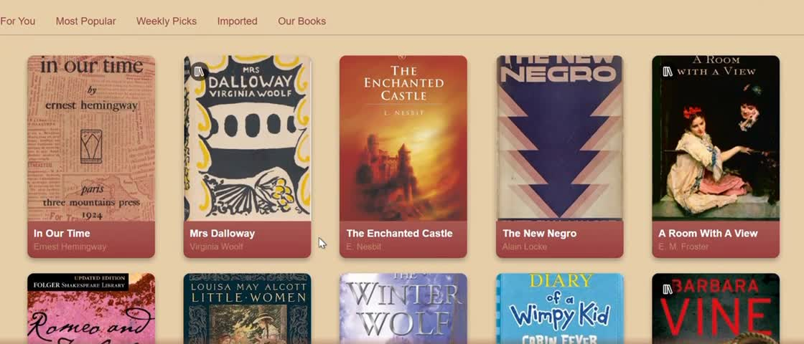

DEMO
website development
lovable.dev
video generation
meta.ai
voice generation
naturalreaders.com

Slide 8
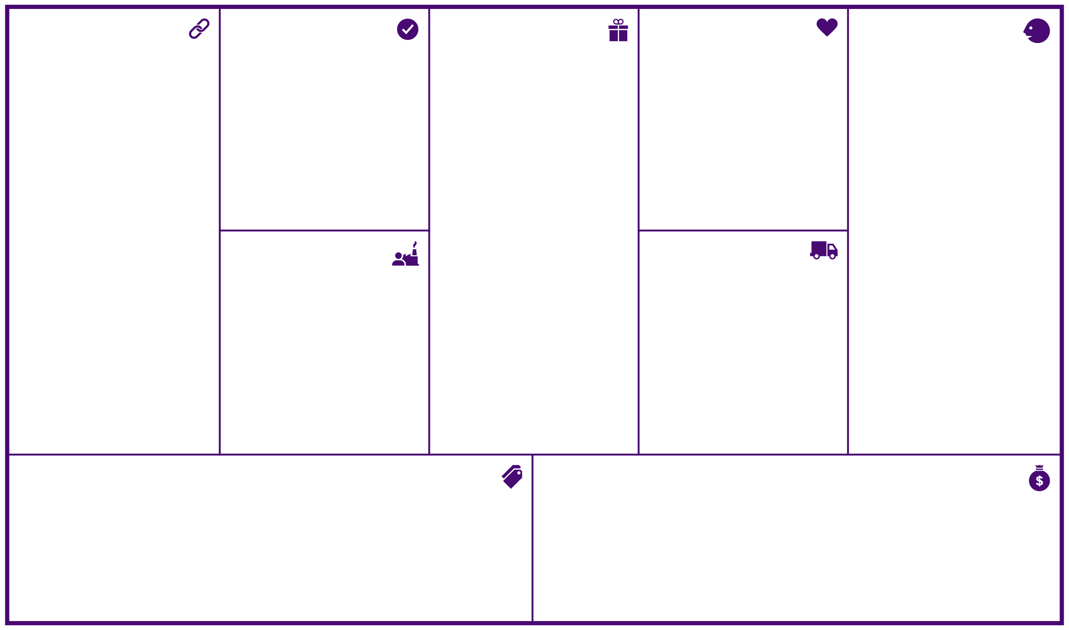
BUSINESS MODEL CANVAS
Key Partners
Key Activities
Value Propositions
Customer Relationships
Customer Segments
Strategic Alliances:
Apple (apple vision) and other VR companies
Amazon (bundles, gift cards)
Disney (story writing)
Authors
Design companies
Competition
Video books production companies
Content acquisition and production
Platform development and maintenance
Data & algorithm management
Marketing & customer acquisition
Partnerships & distribution
Customer support & expertise
for segment 1 (readers):
Vast library of videobooks and visual content
High-quality visuals and scenery
Exclusive member benefits and discounts
Personalized recommendations
User-friendly app and interface
Offline listening
Time-saving entertainment and education
Access to original content
Ensure great user recommendation to retain current customer base
Build and secure a partnership with Studios and content production houses
Comply with the laws (laws as per to State or Region/country), maintaining compliance to censorship, specifically for minors and children
for segment 2:
provide all the help needed to design their own visual books
market for their books and recommend them for customers
for segment 1 (readers):
personal assistance through: Customer support (automated – chatbots/ personal assistant)
self-service: (main service) purchasing and browsing through the app/software on their own
automated service: visual book Recommendation system
communities: Reading discussions
co-creation: book Reviews
for segment 2:
dedicated personal assistance: Authors hunting and maintaining relationships
co-creation: in the creation and design of the scenes
segment 1 (readers):
owners of VR sets
Book readers (of ages 6+)
Visual readers
Dyslexic people
Students
VR owners
segment 2:
Writers
Publishers of Physical Books
Producers of VideoBooks
Key Resources
Channels
Physical (distribution networks)
Intellectual (brand, copyrights)
Human: software developers, dedicated personnel, customer support, marketing, authors, AI engineers, primer graphic designers
Awareness (social media and book influencers)
Evaluation (a pop-up feedback)
Purchase and delivery (app/software)
After sale (chatbots, communities, live chats)
Cost Structure
Revenue Streams
Cost of designing the scenes
Cost of recommendations and AI algorithms
Logistics
Cost of developing the app/software
Infrastructure (data centers) cost of streaming content
Employee salary distribution (customer service, Engineers, etc.)
Cost of producing books and their visuals
revenues from segment 1 (readers):(transaction revenues)
Asset sale: buy books at Fixed menu prices (range based on economy)
revenues from segment 2:(recurring revenues)
usage fees: using the design visuals book services
Ads: to recommend publishers’ books on top

Slide 9


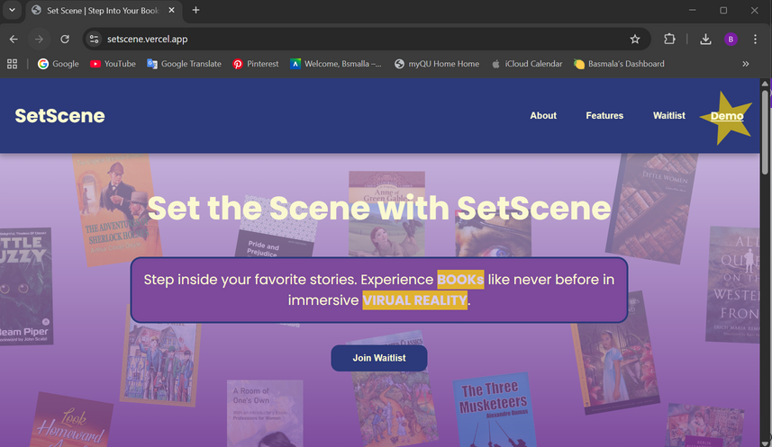
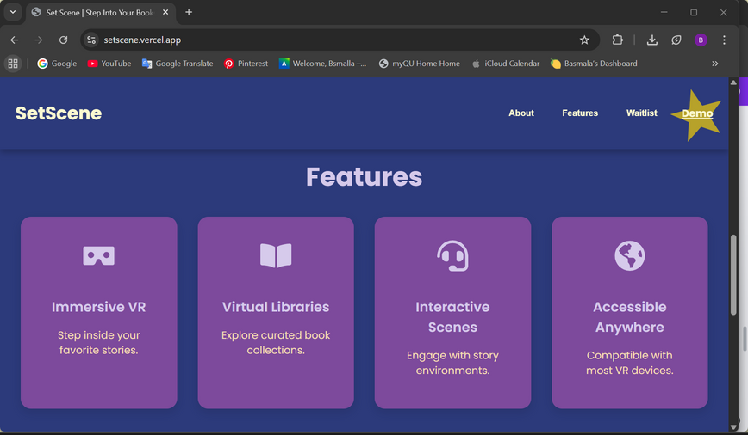

OUR LANDING PAGE
our website
2. survey
3. analysis

Slide 10
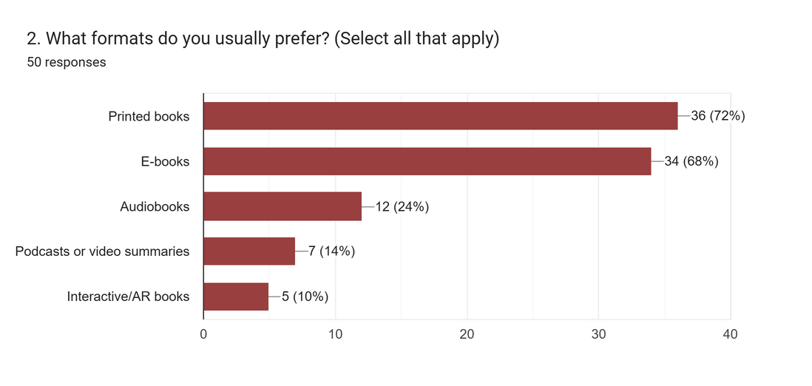
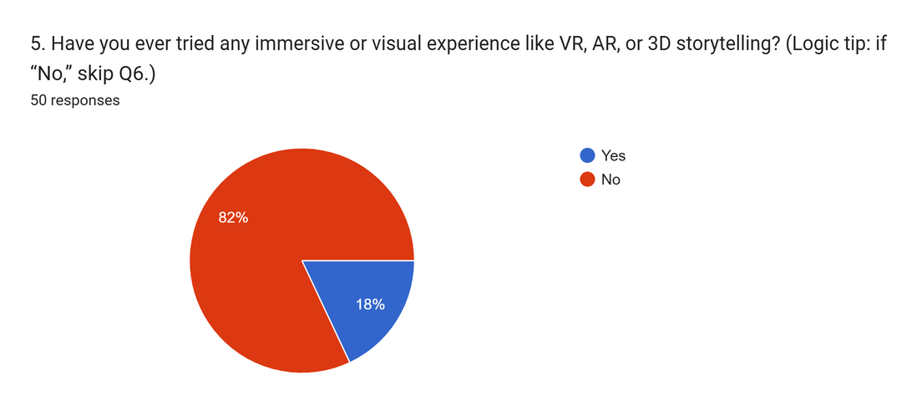
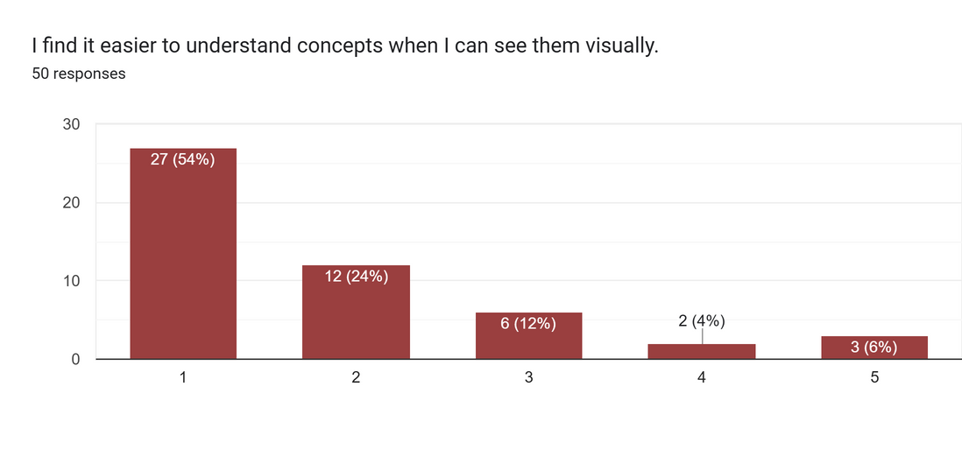
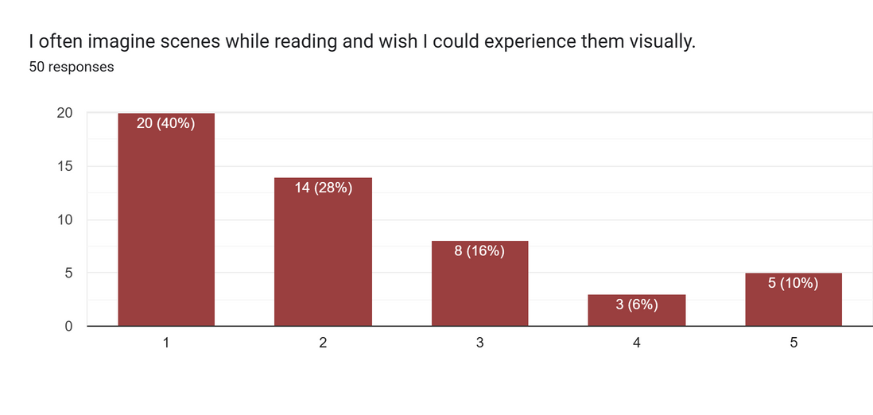
FORM/ SURVEY

Slide 11
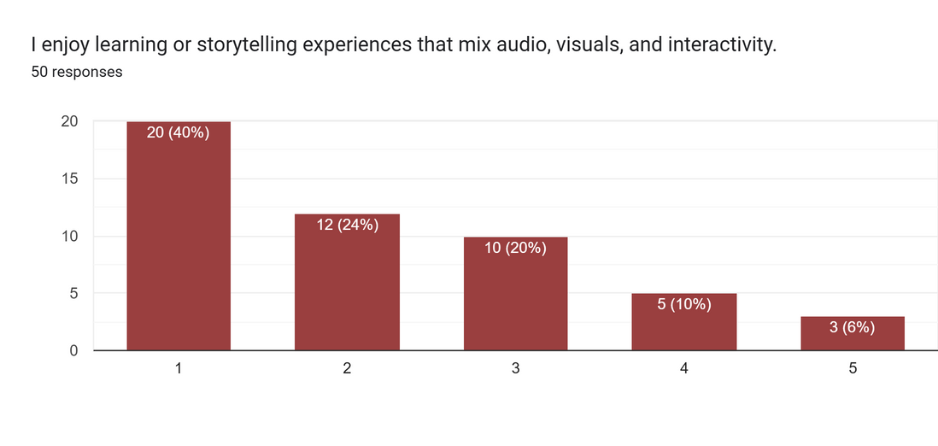
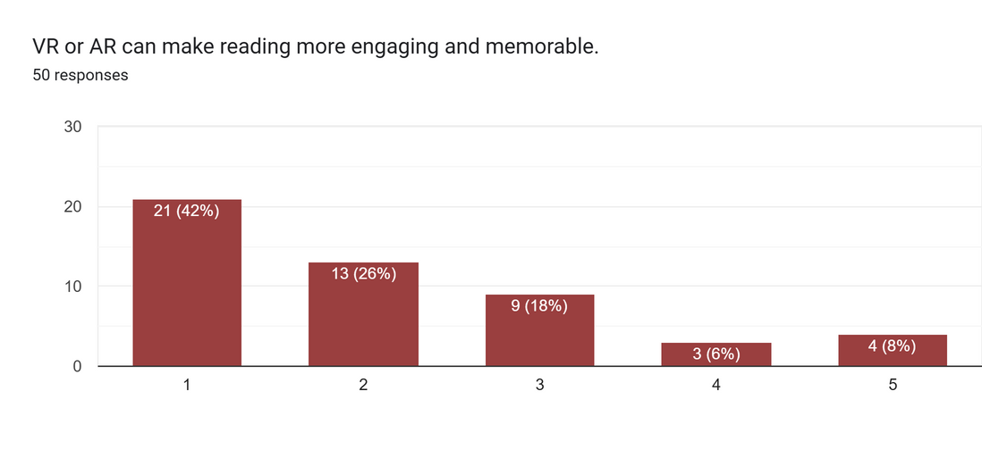
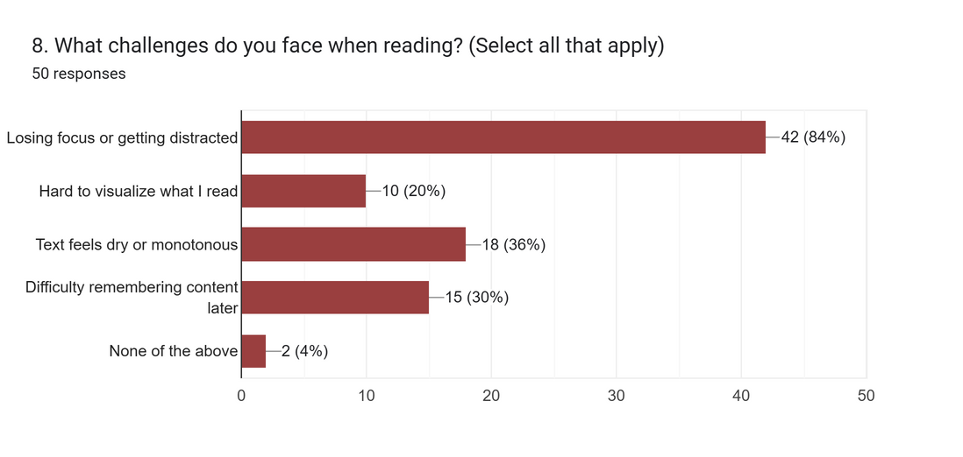
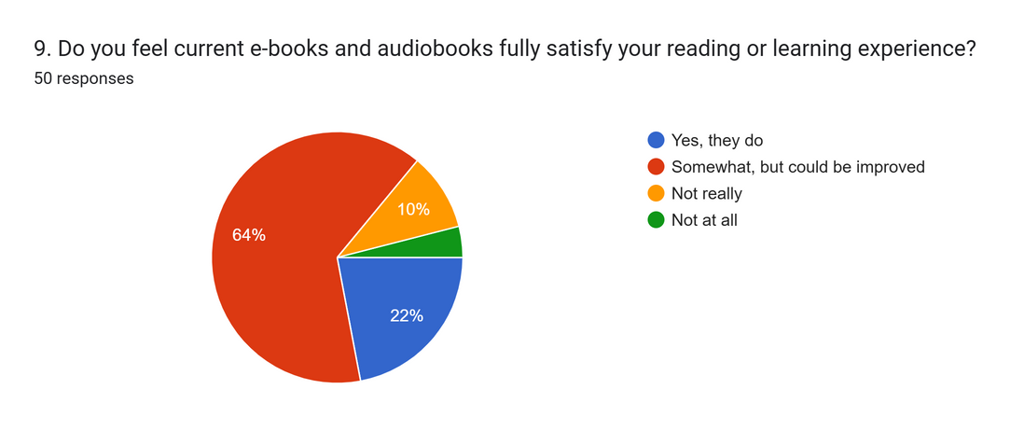
FORM/ SURVEY
cont.

Slide 12
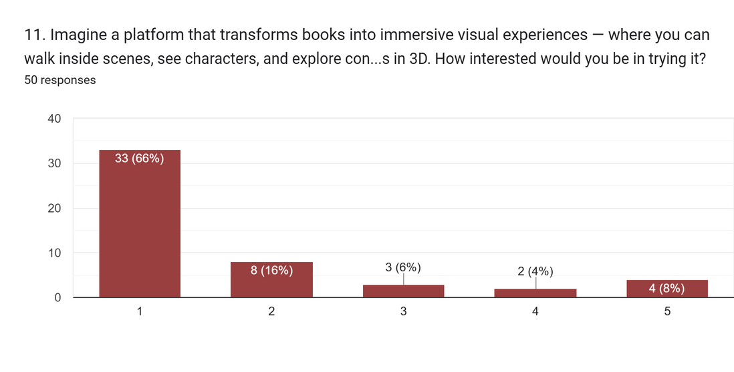
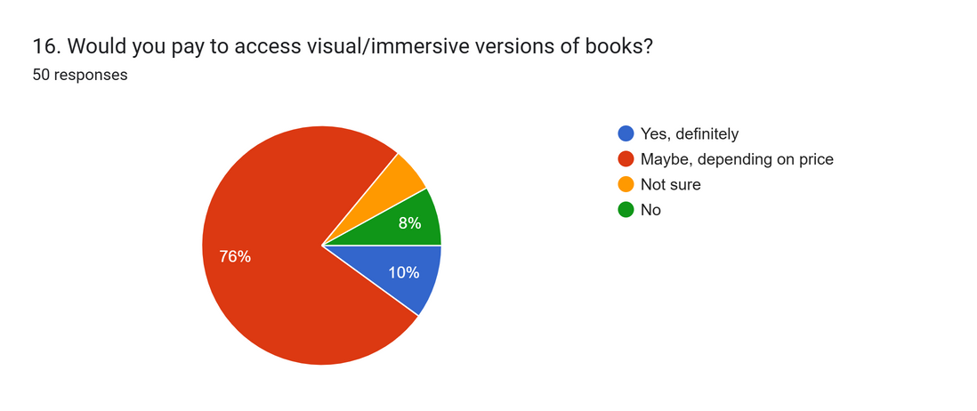
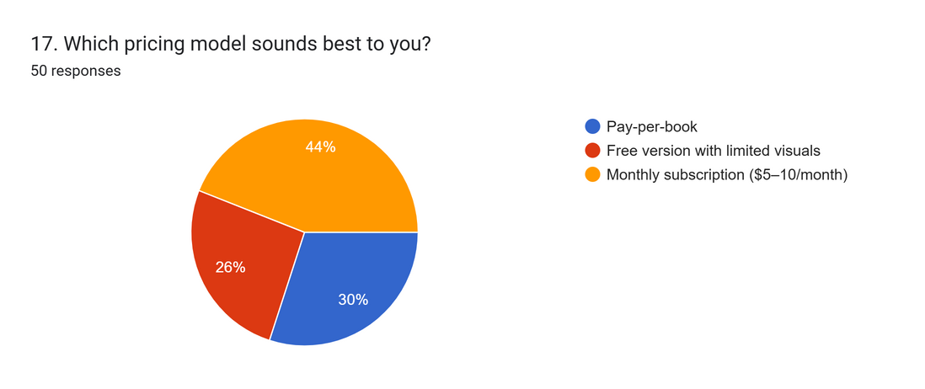
FORM/ SURVEY
cont.

Slide 13

FINANCIAL HIGHLIGHTS (2025–2027)
Data-Driven Inputs
50-user survey:
82% high interest in immersive visual books
86% open to paying
Clear preference for subscription ($5–10/ month)
Landing page (151 visitors):
22.5% waitlist conversion (strong signal)
34 early adopters

Slide 14
FINANCIAL HIGHLIGHTS (2025–2027)
cont.
Pricing Strategy (Hybrid Model)
Subscription: QAR 25–30/month
Pay-per-book: QAR 25–30 per v-book
Freemium tier for acquisition + conversion funnel
User Growth (Active Paying Users)
2025: 1,000
2026: 3,000
2027: 6,000

Slide 15
FINANCIAL HIGHLIGHTS (2025–2027)
cont.
Projected Revenue
2025: QAR 90,000
2026: QAR 360,000
2027: QAR 1,050,000
Cost Structure (Lean Model)
Dev & maintenance: QAR 120k → 40k → 60k
Hosting + AI/Cloud: QAR 30k → 38k → 46k
Marketing: QAR 12k/year
Profitability
2025: –95,000 (expected startup loss)
2026: +208,800
2027: +797,400

Slide 16
FINANCIAL HIGHLIGHTS (2025–2027)
cont.
Break-even
Break-even at ≈5,600 units
Expected to reach mid-2026
Funding Ask (Seed Round)
QAR 200,000–500,000
To cover development, hosting, AI costs, early hires & growth

Slide 17
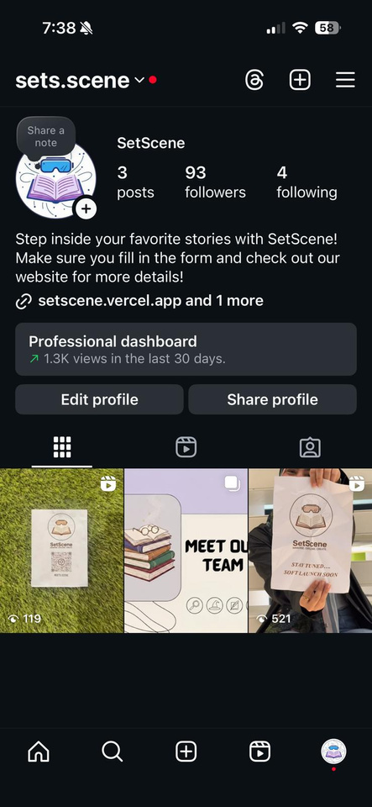
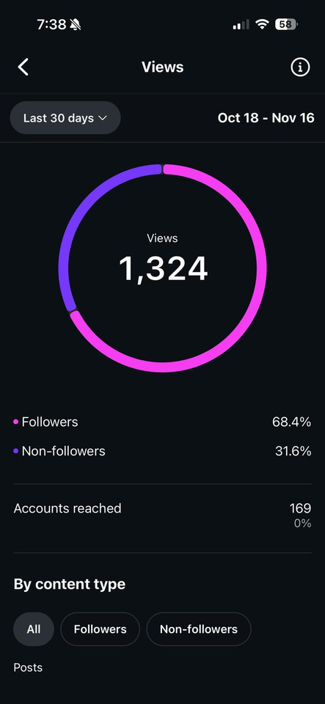
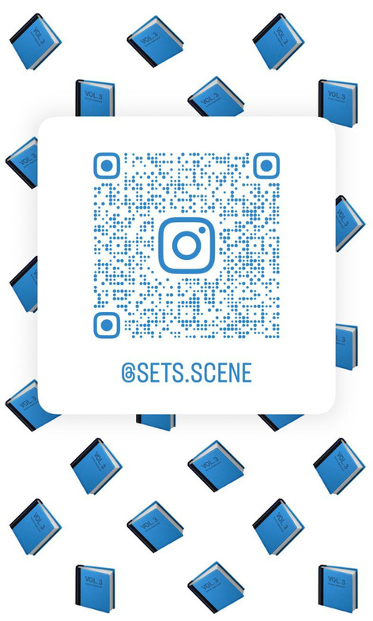

INSTAGRAM

Slide 18
SWOT ANALYSIS - STRENGTHS
Unique VR reading concept: Moves beyond gaming; transforms books into interactive, immersive adventures.
High engagement: Users see, hear, and feel the story, building stronger emotional connection.
Multi-use product: Works for education and entertainment.
Highly versatile: Supports novels, children’s books, fantasy, horror, and educational content.

Slide 19
SWOT ANALYSIS - WEAKNESSES
High development cost: VR + software requires significant funding.
Small VR adoption: VR mostly used by gamers; many readers don’t use VR yet.
New, unfamiliar market: VR reading is not common, causing slower initial adoption.

Slide 20
SWOT ANALYSIS - OPPORTUNITIES
Growing global VR adoption: Increasing demand for immersive storytelling.
Education use cases: Schools/universities can use it for visual learners & difficult chapters.
Partnership potential: Authors/publishers can bring their stories to VR.
Qatar support: Strong government funding for tech and innovation.
Multilingual expansion: Arabic + English content for local and international audiences.

Slide 21
SWOT ANALYSIS - THREATS
Big competitors entering later: Large tech firms could copy the idea with bigger budgets.
Traditional reading preference: Some readers prefer normal books over tech.
VR cost barriers: Users may hesitate due to high VR device prices or subscription fees.
Licensing challenges: Popular books require expensive content rights.

Slide 22
CHALLENGES
Product Development
Slow dev cycles + incomplete testing
Cross-platform & integration issues
Scalability + security vulnerabilities
Infrastructure & Operations
Server downtime & cloud cost spikes
Weak backup/disaster recovery
Scaling issues under user growth
Data & AI Systems
Limited datasets + expensive training
Weak analytics & MLOps pipelines
Privacy/compliance risks (GDPR, etc.)

Slide 23
CHALLENGES
cont.
Software & Tools
Fragmented toolchain, weak CI/CD
Integration issues (design ↔ dev)
Payment gateway failures/compliance issues
Team & Organization
Hard to hire VR/3D/AI talent
Undefined roles + weak leadership
Collaboration or co-founder conflicts
Financial
Limited runway; cost overruns
Overestimated revenue
Difficulty raising investment

Slide 24
CHALLENGES
cont.
Marketing & Growth
Low brand awareness, weak acquisition
High CAC + low retention
Poor feedback loops & funnel optimization
Legal & Compliance
Founder/IP ownership issues
Contract & regulatory risks
Data protection non-compliance
Customer, Partner & External
Weak support & feedback collection
Unreliable partners/suppliers
Market/economic or tech trend shifts

Slide 25
MARKET FEASIBILITY STUDY
Target Market
Readers: students, dyslexic/visual learners, general readers, VR owners
Creators: authors, publishers, visual artists
Clear earlyvangelists with strong need + high willingness to try new formats
Demand Evidence
Survey + landing page show strong interest & willingness to pay
Qatar/MENA: high literacy, rising VR adoption, fast-growing e-learning market
Global trends: immersive learning, digital entertainment, multimedia reading
Competitive Landscape
Direct: Audible, Storytel
Indirect: Netflix, Kindle, YouTube learning
Gap: No VR-first videobook platform in MENA → strong first-mover advantage
Differentiation: VR immersion, AI recommendations, reader–creator ecosystem

Slide 26
MARKET FEASIBILITY STUDY
cont.
Customer Insights
Earlyvangelists: dyslexic readers, students, VR users, authors
Validation tools: landing page MVP, mock sales, Wizard-of-Oz tests, A/B testing, focus groups
Strong evidence of real market need before full development
Regulatory Feasibility (Qatar)
Manageable copyright & publishing licensing
Standard content compliance for minors
Qatar favors tech/creative startups; easy registration via “Startup Qatar”
Financial Feasibility
Revenue: subscriptions, per-book sales, premium tiers, creator revenue share
Costs: VR app development, AI engine, cloud streaming, marketing
Strong funding access: QDB, QSTP, Mada (assistive tech), Tamkeen, MCIT, YEC

Slide 27
MARKET FEASIBILITY STUDY
cont.
Strengths
First VR videobook platform in the region
Multiple revenue streams; high societal impact
Strong alignment with digital learning trends
Weaknesses
VR adoption still growing
Higher initial development + content production costs
Opportunities
Rising VR usage across GCC
No regional competitors
Government support for VR, AI & EdTech innovation
Threats
Global giants could enter later
Cultural or regulatory content restrictions
Overall Feasibility
Market Feasibility = Strong
SetScene is well-positioned for launch in Qatar with high regional expansion potential.

Slide 28
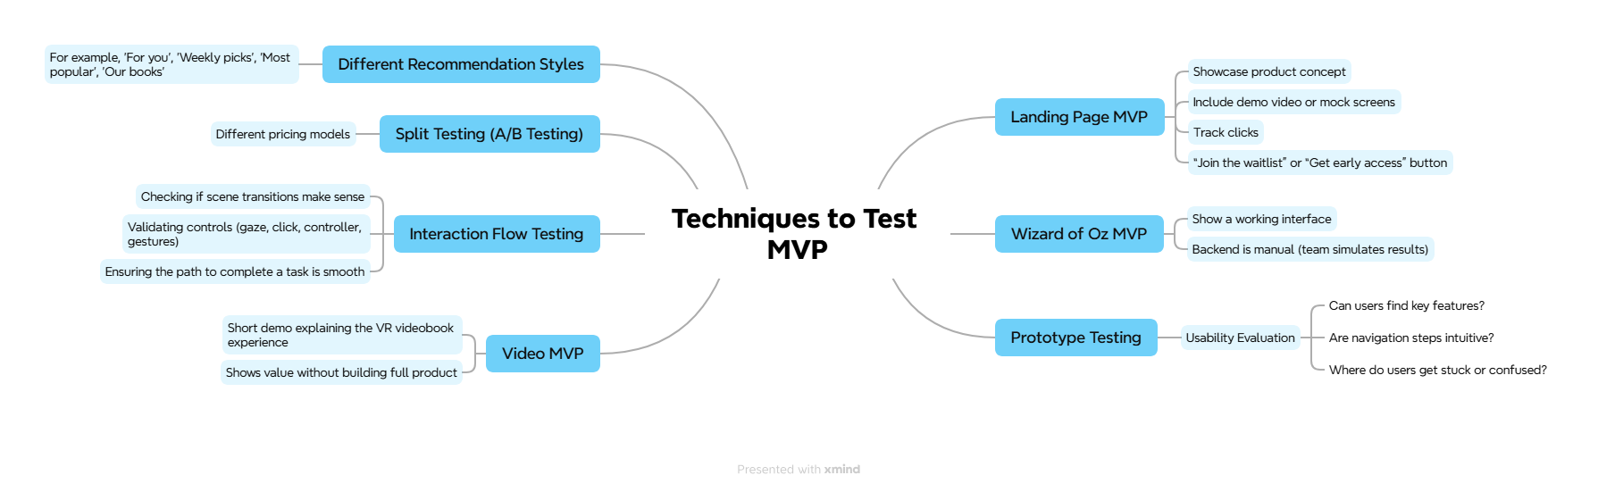
MIND MAPS

Slide 29
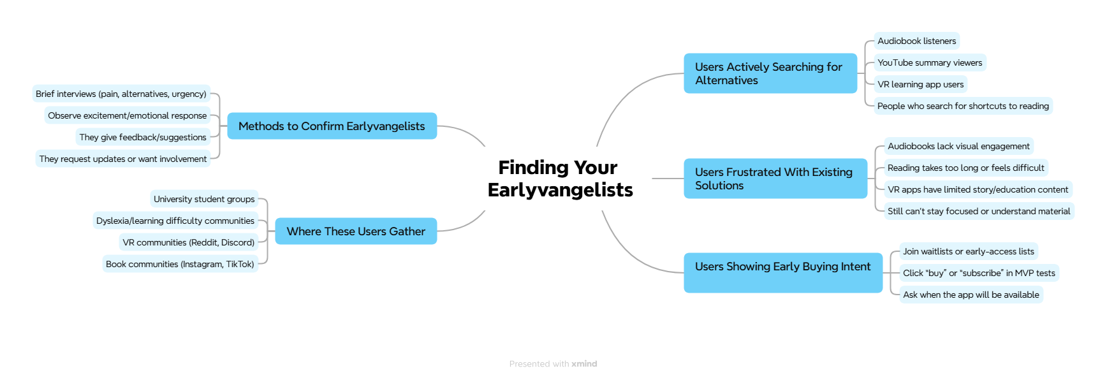
MIND MAPS
cont.

Slide 30
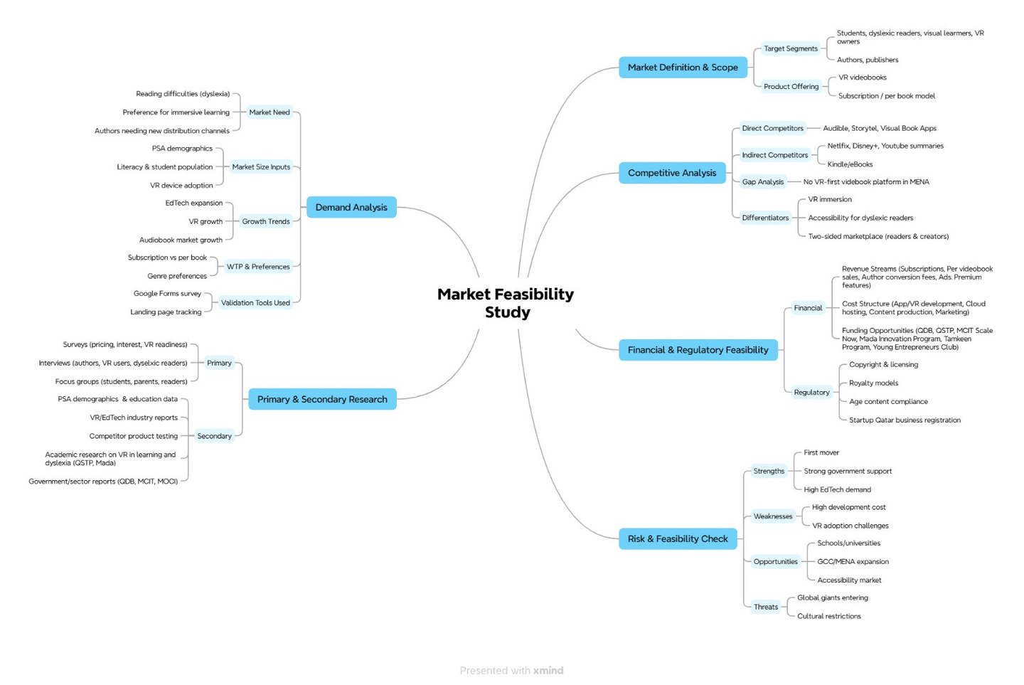
MIND MAPS
cont.

Slide 31
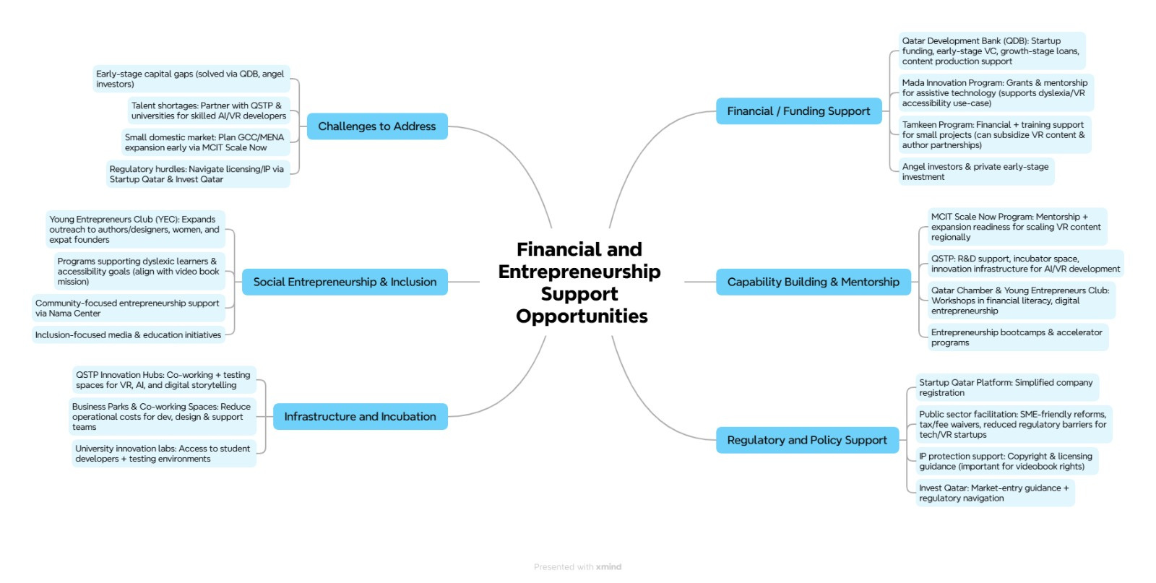
MIND MAPS
cont.

Slide 32
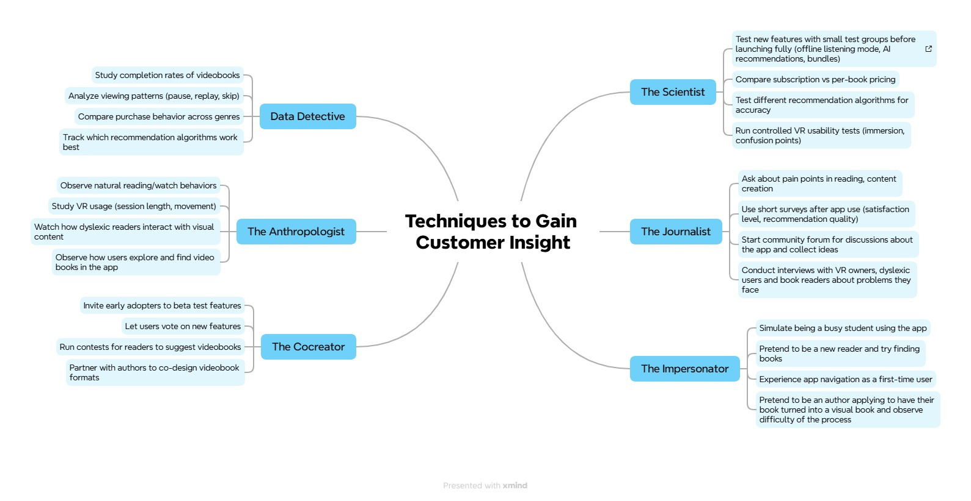
MIND MAPS
cont.

Slide 33
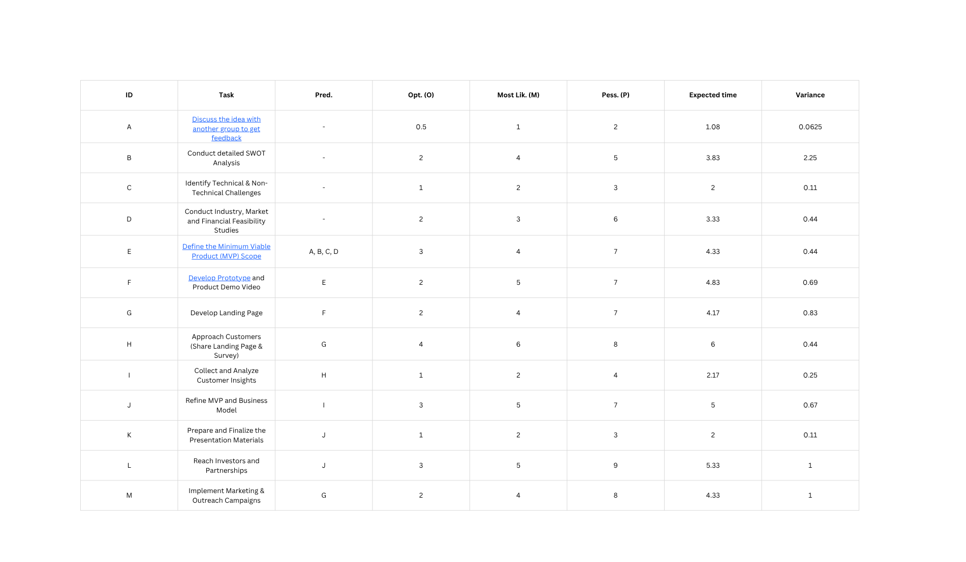
ACTIVITIES SCHEDULING (PERT)

Slide 34
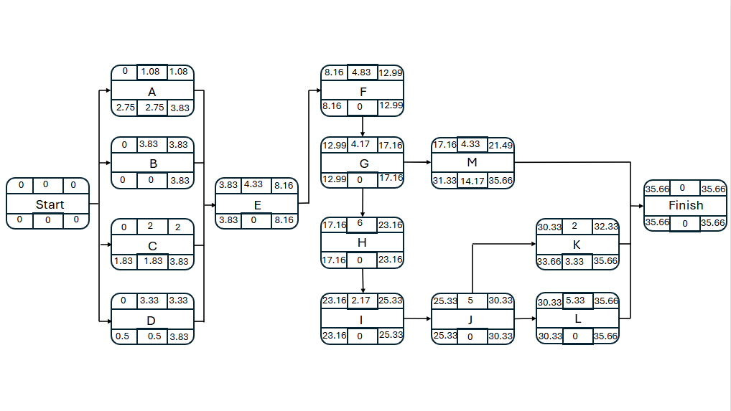
ACTIVITIES SCHEDULING (PERT)
cont.

Slide 35
feel free to ask any questions !!
THANK YOU FOR LISTENING!

